Slide 1










DESIGN PROJECT - I
PROPOSAL PRESENTATION
CANVAS
1

Slide 2






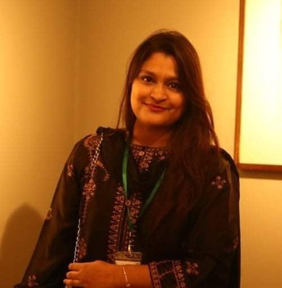

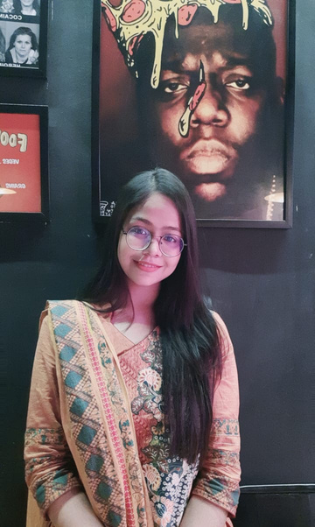
MEET THE TEAM
NAFISA TABASSUM
AJWAD ABRAR
PRIANKA MAHERU
190042104
190042106
190042112
Software Engineering
Islamic University of Technology
2

Slide 3



Canvas is an online art exhibition platform where different types of exhibitions can be arranged virtually.
PROJECT
OVERVIEW
User can explore this platform virtually by getting registered.
Users -
Organization ( creates exhibition)
Art enthusiast ( explore exhibition )
Admin ( control overall system)
3

Slide 4




PROBLEM STATEMENT
No dedicated platform for online exhibition in Bangladesh to the best of our knowledge.
Much hassle & time in Offline exhibitions.
Categorizing the exhibition according to user interest which is not possible in offline exhibition.
4

Slide 5
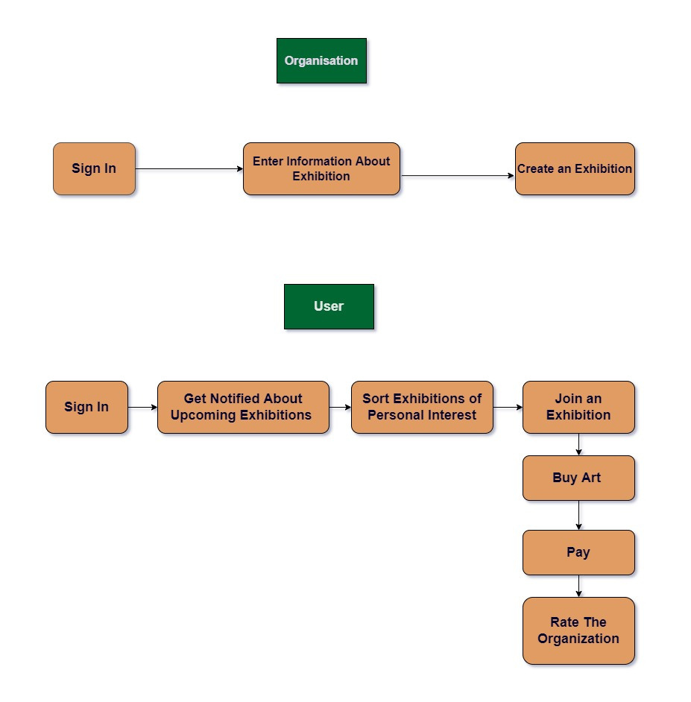
PROCESS
FLOW
5

Slide 6




AUTHENTICATION & USER PROFILE
01
02
EXHIBITION CREATION
CORE FEATURES
UPCOMING EXHIBITION & REMINDER
03
04
BUY & SELL ART
6
05
RATING SYSTEM

Slide 7




Authentication & User profile
01
Organization & users can authenticate themselves using this web app.
They will have their own profile in this application.
7

Slide 8
Exhibition Creation
02
Organization can create their exhibition by entering the exhibition info( time slot, art info, exhibition type)
8

Slide 9
Upcoming Exhibition & Reminder
Getting notified about the upcoming exhibitions in the feed.
Sorting the exhibitions according to user interest.
Getting reminder about the exhibitions (s)he has shown interest.
03
9

Slide 10
Buy & Sell Art
04
User can buy the arts which are up for sale within the exhibition time.
Organization will provide the sale info of the arts.
10

Slide 11
Rating System
05
User can rate the exhibition & the rating will be added to the organization profile.
11

Slide 12






TECHNOLOGY
SOURCE CONTROL
PLATFORM
FRONT END
BACK END
DATABASE
HTML
CSS
Bootstrap
Javascript
Web application
Django framework
SQLite/
PostgreSQL
Github
12

Slide 13





PROJECT TIMELINE
AUG 1 - AUG 25
AUG 26 - SEP 25
SEP 20 - NOV 10
NOV 10 - NOV 18
Brainstorming
Project idea selection
Project requirement analysis
Front End Learning & Development
Backend learning & development
Database learning & development
Debugging
Completion of the project
13

Slide 14
PROJECT TIMELINE
AUG 1 - AUG 25
AUG 26 - SEP 25
SEP 20 - NOV 10
NOV 10 - NOV 18
Brainstorming
Project idea selection
Project requirement analysis
Front End Learning & Development
Backend learning & development
Database learning & development
Debugging
Completion of the project

Slide 15


THANK YOU
ANY SUGGESTION WOULD BE APPRECIATED
14

